Slide 1
CIS212 Lab Week #4
Extending the C Basics – Arrays & Strings

Slide 2
CIS212 Lab Week #4
Extending the C Basics – Arrays & Strings

Slide 3
Just a Name Change?
Arrays are a kind of data structure that can store a fixed-size sequential collection of elements of the same type.
Sound familiar?
Just like Lists in Python!

Slide 4
Properties of Arrays
Like Lists, arrays start at an index of 0 and have their last entry at an index of size – 1.

Slide 5
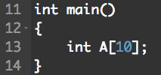
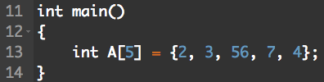
Creating Arrays
Declare, fill later. (Can create problems, if you are not careful. Why?)
Initialize at creation.

Slide 6
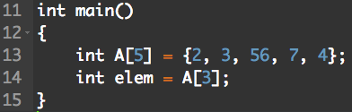
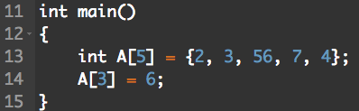
Array Operations
Access an element
What is the value of elem?
Reassign an element

Slide 7
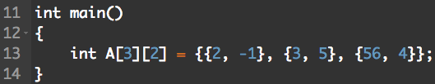
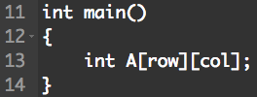
2D Arrays
How do you create a 2D array?
Which number refers to the row? Column?

Slide 8
CIS212 Lab Week #4
Extending the C Basics – Arrays & Strings

Slide 9
From Arrays to... Arrays!
Strings are just arrays made of chars

Slide 10
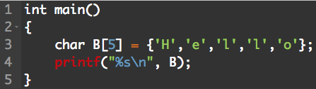
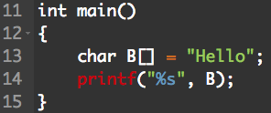
Bit by Bit… Too Much!
Just like arrays, but with char
Too much of a hassle! What’s a better way?

Slide 11
String Operations
There’s a whole library!
Import string.h for the full list
A few ones we will focus on:
strcpy
strcat
strcmp
strlen

Slide 12
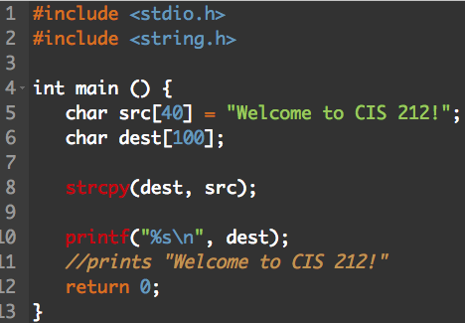
Copy and Paste
char* strcpy(char* dest, const char* src)
Copies the string src into the variable dest, returning the resulting string in dest.
Example:

Slide 13
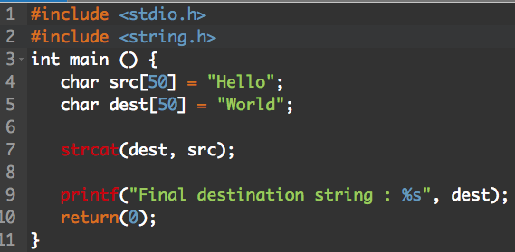
Smoosh Everything Together
char* strcat(char* dest, const char* src)
Appends the string src onto the end of the variable dest, returning the resulting string in dest.
Example:
Why are these
important?

Slide 14
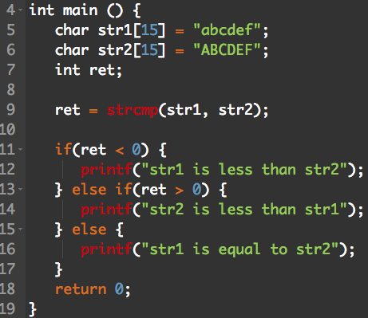
Time to Sort!
int strcmp(const char* str1, const char* str2)
Compares str1 to str2, returning an integer.
return < 0 if str1 < str2
return = 0 if str1 = str2
return > 0 if str1 > str2
Example:

Slide 15
The Values of Letters
Each char has an unsigned integer equivalent.
These values can be found on the Standard ASCII table
Using strcmp, which will get sorted first, ”apple” or “Banana”?

Slide 16
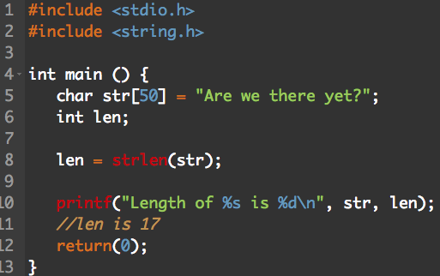
Yep, Just like an Array
size_t strlen(char* str)
Returns the length of the string str, not including ‘\0’.
Example:

Slide 17
Start the Exercise…
As always, you may use Google and man to help you answer any of the questions!

